Slide 1
MEDICAL SURGICAL NURSING II
ORAL HEALTH ,ALIMENTALY AND BILIARY CONDITIONS

Slide 2
MODULE OBJECTIVES
By the end of this section you will be able to:
Describe the structure and function of the digestive system
Describe the function of the accessory structures of digestion
Describe food metabolism.
Diagnose ,manage and rehabilitate patients with dental, alimentary and biliary conditions.
Utilise the nursing process in the management of adults with disorders of the digestive system and associated organs.

Slide 3
On completion of this chapter, the learner will be able to:
1 Describe the nursing management of patients with conditions of the oral cavity.
2 Describe the relationship of dental hygiene and dental problems to nutrition.
3Describe the nursing management of patients with abnormalities of the lips, gums, teeth, mouth, and salivary glands.
4 Describe the nursing management of patients with cancer of the oral cavity.
5 Identify the physical and psychosocial long-term needs of patients with oral cancer.
6 Use the nursing process as a framework for care of patients undergoing neck dissection.
7 Use the nursing process as a framework for care of patients with various conditions of the esophagus.
8 Describe the various conditions of the esophagus and their clinical manifestations and management.

Slide 4
The Gastrointestinal Tract
The gastrointestinal tract is a long tubular structure, which starts at the mouth and ends at the anus.
The walls of the tract from the oesophagus onwards form four layers of tissues.
The layers are :
the adventitia or outer covering,
muscle layer,
submucous layer,
mucous membrane lining.
The tract is well supplied with nerves and blood vessels.

Slide 5
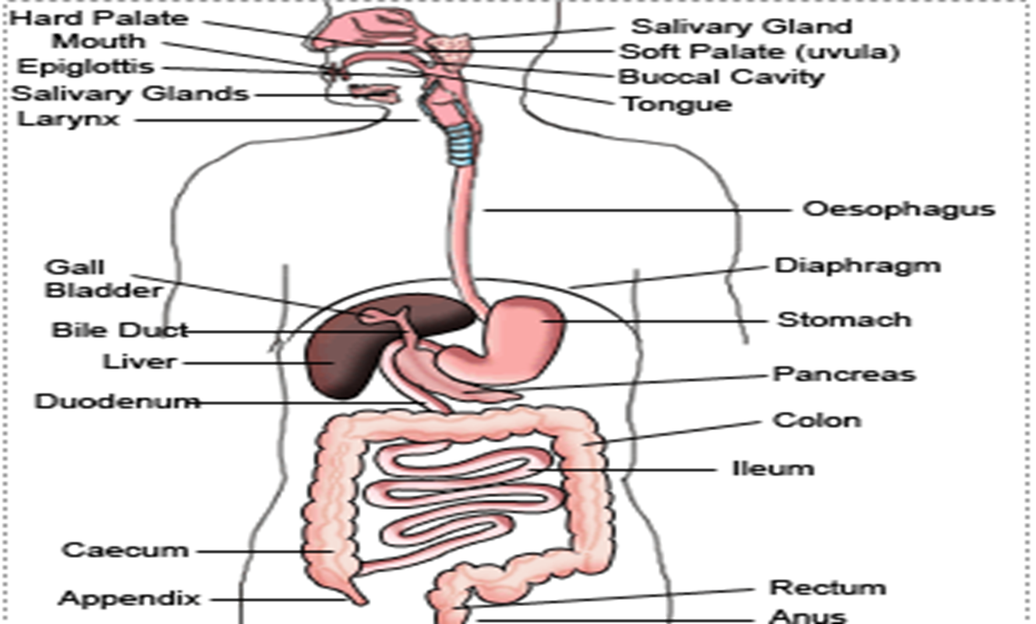
THE DIGESTIVE SYSTEM

Slide 6
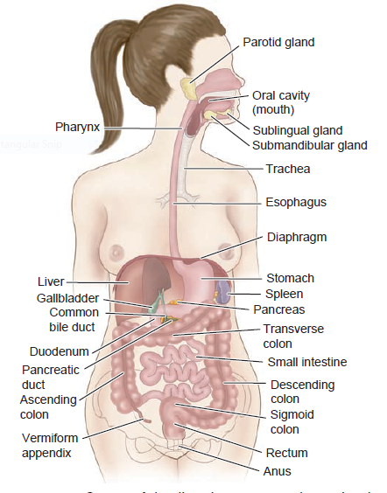
The digestive system

Slide 7
REVIEW THE ANATOMY AND PHYSIOLOGY OF THE DIGESTIVE SYSTEM
The functions the digestive system can be grouped under five main headings:
Ingestion. This is the process of taking food into the mouth, chewing and alimentary tract.
Secretion: This is secretion of digestive juices this include saliva, Mucus, HCL, enzymes, and bile.
Propulsion. This moves the contents along the alimentary tract.
Digestion. This consists of:
mechanical breakdown of food by, e.g. mastication (chewing)
chemical digestion of food by enzymes present in secretions produced by glands and accessory organs of the digestive system.
Absorption. This is the process by which digested food substances pass through the walls of some organs of the alimentary canal into the blood and lymph capillaries for circulation round the body.
Elimination. Food substances which have been eaten but cannot be digested and absorbed are excreted by the bowel as faeces.

Slide 8
Exercise
CLASSES OF FOODS
DIGESTION PROCESS
END PRODUCTS OF DIGESTION
SITES OF ABSORPTION

Slide 9
THE MOUTH
This is also called the oral cavity.
Food taken in is chewed and mixed with saliva that contains the enzyme amylase (ptyalin).
The tongue, which performs taste functions, turns the food in the mouth that is called mastication and also assists in swallowing.
The pharynx is also involved in food swallowing before the food moves into the oesophagus.

Slide 10
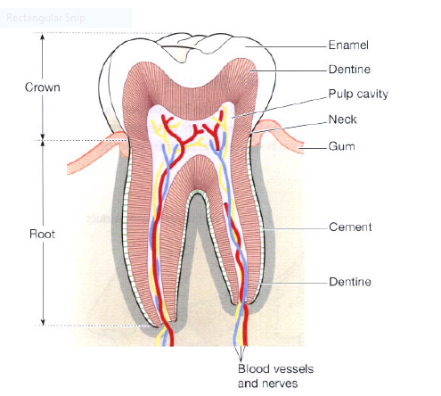
DISORDERS OF THE ORAL CAVITY 1. PLAQUE AND TOOTH DECAY/DENTAL CARIES- A section of a Tooth

Slide 11
Tooth decay is an erosive process that begins with the action of bacteria on fermentable carbohydrates in the mouth, which produces acids that dissolve tooth enamel.
Acid is produced by bacteria when they break food or sugar on the tooth surface.
Tooth enamel is the hardest substance in the human

Slide 12
Pathophysiology
Acid is produced by bacteria when they break food or sugar on the tooth surface.
Prolonged exposure to lactic acid from bacteria causes demineralization of the crystals in the enamel
Bacteria penetrates the dentin, decay progresses more rapidly and in time reaches the pulp cavity of the tooth.
Acid is produced by bacteria when they break food or sugar on the tooth s
Diagnosis:
Clinical examination
Radiographs

Slide 13
Contributing factors to dental erosion
Nutrition: taking food rich in refined sugar e.g. soft drinks
Genetic predisposition
Presence of dental plague: dental plague is a gelantic-like substance that adheres to the teeth, the initial action that causes damage to the tooth occurs under dental plaque.
Diseases that results to decreases in saliva such as diabetes.
Medication that decrease saliva production e.g. antihistamines and antidepressants
Poverty
Poor cleaning of the mouth and receding gum.
Age related oral dryness.

Slide 14
Treatment
Enamel demineralization: brushing with fluoride and flossing application by the dentist is enough to stop the progression of tooth decay
Dental restoration( dental filling /crown ): done when tooth decay has reached the soft dentine the tooth can not repair its self.
Root canal treatment
Tooth extraction
Tooth replacement

Slide 15
Complications
On going tooth pain.
Tooth abscess.
Sepsis.
pus around the affected tooth.
Risk of breaking or chipping of the tooth.
Difficult in chewing food.

Slide 16
Prevention of dental caries
Regular cleaning of teeth: brushing teeth after every meal and at least twice daily
Flossing between teeth at least once daily
A diet low in starches, sugar and high in fruits vegetable and nuts and plain yogurts, calcium rich food, xylitol sugarless chewing gum, unsweetened black and green tea
Small amount of fluoride in form of fluorinated water, tooth paste and salt
Refraining from smoking: smoking decreases would healing, suppresses antibody production, it reduces neutrophilic phagocytosis
Controlling diabetes
Dental Screening regularly can result to early detection.

Slide 17
2. ORAL THRUSH /ORAL CANDIDIASIS
Oral thrush is a cheesy white plaque that looks like milk, when rubbed off, it leaves an erythematous and often bleeding base.
Causes:
candida ALBICANS fungus,
others are c. TROPICANS and C. GIBRATA
Predisposing Factors:
a) Local factors:
Dentures: The mucosal is sheltered from oxygen and saliva.
Corticosteroid inhalers.
Reduced salivary flow.
High sugar diet.

Slide 18
b) Systemic factors
Extreme ages (the very young and the old).
Endocrine disorders (e.g. diabetes).
Immunosuppression.
Broad spectrum antibiotics.
Nutritional deficiency
Smoking
Diagnosis:
Clinical examination
Oral swabs for culture and sensitivity
Oral rinse and oral smear

Slide 19
Signs and symptoms
Creamy white lesions on your tongue, inner cheeks, and sometimes on the roof of the mouth, gums and tonsils.
Slightly raised lesions with a cottage cheese like appearance.
Redness, burning or soreness that may be severe enough to cause difficulty eating or swallowing.
slight bleeding if lesions are rubbed or scraped.
Cracking and redness at the corners of your mouth.
A cottony feeling in your mouth .
Loss of taste redness, irritation and pain under the denture,

Slide 20
Treatment / nursing care
Anti fungal medication e.g. nystatin (mycostatin), amphotericin B, clotrimazole or ketoconazole.
When using the suspension the patient should whish vigorously for at least one minute then swallow.
Treat the cause e.g.
Rinse mouth with water after using a corticosteroid inhaler or use a spacer device.

Slide 21
Prevention
These the risk of candidiasis
Rinse the mouth : if you have to use a corticosteroid inhaler, be sure to rinse your mouth with water or brush your teeth after taking your medication.
Brush your teeth at least twice daily a day and floss daily or as often as your dentist recommend.
Check your dentures: remove your dentures at night, make sure denture fit properly and do not cause irritation, clean your dentures properly.
See your dentist regularly: especially if you wear dentures or you are diabetic.
Watch what you eat: limit sugary foods they encourage growth of candidiasis
Treat and control blood sugar diabetes
Treat vaginal yeast infection
Treat dry mouth; ask your doctor about to avoid or treat dry mouth.ways

Slide 22
3. STOMATITIS
Stomatitis is the inflammatory process affecting the mucous membrane of the mouth and lips with or without oral ulceration “stoma” (Greek word meaning mouth) “itis” meaning inflammation.
Stomatitis can disrupt a patients ability to eat, talk and sleep
Can occur anywhere in the mouth e.g. cheecks, gums, tongue, lips and palate.
Sings and symptoms:
Mild redness and edema
Severe, painful ulceration, bleeding and secondary infection.

Slide 23
Possible causes
Trauma is the most common cause of stomatitis
Infections such as bacterial or viral
Burns especially from hot food and drink
Allergic reactions
Smoking or chewing tobacco
Nutritional deficiency:
Malnutrition
Malabsorption can lead to nutritional deficiency then stomatitis e.g. iron, vitamin B2 (niacin), vitamin B6 (pyridoxine), vitamin B9 (Folic Acid), OR Vitamin B12 ( cobalamine).
Chemotherapy
Radiotherapy
Severe drug allergy
Myelo suppression ( bone marrow depression)

Slide 24
Types:
Apthous stomatitis (canker sores): this is a recurrent appearance of mouth ulcers in otherwise healthy individuals. Cause : unknown but is thought to be a t-cell mediated response triggered by a variety of factors, no cure just relieve of symptoms.
Angular stomatitis ( angular cheilitis): this is the inflammation this is the corners ( angles of the mouth).In children a sign of repeated lip licking. In adults, a sign of iron deficiency anaemia, vitamin B (B2, B9, )
Denture Related Stomatitis: it appears as a painless mucosa beneath the denture, 90% associated with candida species and it is the most common oral candidiasis. Treatment with ant fungal medication.
Allergic contact stomatitis (allergic gingivitis) this is a type iv delayed hypersensitivity reaction that occurs in susceptible atopic individuals when allergens penetrate the skin.

Slide 25
Herpes gingival stomatitis: inflammation of the mouth caused by herpes simplex virus.
Irradiation and chemotherapy stomatitis
Stomatitis nicotinic (palatal keratosis): common in smokers; the palate appears dry and cracked, and white from keratosis. The minor salivary glands appear, small, red and swollen bumps. The appearance reverses when swelling stops

Slide 26
Treatment:/nursing care
1. Prophylactic mouth care including, brushing, flossing and rinsing the mouth for any patient receiving radiotherapy and chemotherapy
2. Teaching patient proper oral hygiene, including use a soft bristled toothbrush . For painful ulcers, oral swab with a sponge- like applicator can be used in place of a tooth brush
Avoid alcohol based mouth rinses and hot spicy foods
3. Apply topical ant inflammatory, antibiotics and anaesthetic agents as prescribed.

Slide 27
4. GINGIVITIS
Gingivitis is an inflammatory process of the gums. It is caused by bacteria that accumulates on the teeth, this is called plaque
Signs and symptoms:
Swollen gums
Bright red or purple gums
Bleeding gums or bleeding after brushing and or flossing
Bad breath (halitosis)
Diagnosis: from the signs and symptoms

Slide 28
Causes of gingivitis
Poor oral hygiene: food debris, bacterial plaque, and calculus (tartar) accumulate. Gums may also swell in response to normal process such as puberty and pregnancy;
Bacterial infections, inadequate rest, overwork, emotional stress , smoking and poor nutrition may contribute to development of gingivitis;
Herpes simplex virus : this occurs mostly to people who are immunosuppressed
May occur in other infectious processes such as streptococcal pneumonia, meningococcal meningitis and malaria;
Genetic factors;
Pre-existing conditions;eg………….
Age common in the young and very old;

Slide 29
Treatment/ nursing care
Teach patient proper oral hygiene e.g. tooth brushing at least twice a day, flossing at least once a day, use of fluoride, rinsing the mouth when using cortical steroid inhaler, and dental appointments at least every six months.
Use of medication such as topical antiseptics mouth wash
Systemic antibiotics like doxycycline.

Slide 30
Possible Complications
Recurrence of gingivitis
Periodontitis
Infections
Abscess formation of the gingiva or the jaw
Trench mouth ( bacterial infections and ulceration of gums
Swollen lymph nodes
Associated with premature birth or low birth weight

Slide 31
5. Necrotizing gingivitis ( trench mouth)
Necrotizing gingivitis is a progressive painful infection with ulcers, swelling and sloughing off of the dead tissue from the gums due to infection.
Signs and symptoms:
severe gingival pain localized to affected area
Profuse gingival bleeding that require little or no provocation
Interdental papillae are ulcerated with necrotic slough
Oral malodor( halitosis)
Bad taste (metallic taste)
Malaise
Fever
Cervical lymph nodes enlargement

Slide 32
Causes:
Poor oral hygiene
Bacterial infections
Associated to smokers and malnutrition
Associated to inadequate rest, overwork and emotional stress
Diagnosis:
by clinical presentation

Slide 33
Treatment
Irrigation and debridement of necrotic tissues
Oral hygiene
Antibiotics e.g. metronidazole
Irrigate with 2 % to 3% hydrogen peroxide or normal saline
avoid irritants such as smoking and spicy food

Slide 34
6. Periodontitis
Periodontitis is an inflammatory disease that affects the soft and hard structures that support the teeth.
OR the inflammation of the periodontium (the tissue that supports the teeth)
Periodontium consists of:
The gum (gingiva);
Cementum: the outer layer of roots of teeth;
Alveolar bony: (bony sockets into which the teeth are anchor);

Slide 35
Causes
Untreated gingivitis
Poor or inadequate dental hygiene
Inadequate diet
smoking

Slide 36
Signs and symptoms
Redness or bleeding of gums with brushing teeth, using dental floss or when biting on hard food.
Gum swelling that recur
Spitting out blood after brushing teeth
Halitosis or bad breath
Persistent metallic taste in the mouth
Gingival recession resulting in apparent lengthening of teeth.
Deep pockets between teeth and gums
Loose teeth in later stages

Slide 37
Treatment
Instruct client on proper oral hygiene
Brushing, flossing, avoiding sugary foods and drinks
Antibiotics
Analgesics
Dental Surgery

Slide 38
Abscess ( dental alveolar abscess)or peri-apical abscess
peri-apical abscess, more commonly refered to as an abscess tooth, involves collection of pus in the apical dental periosteum.( fibrous membrane supporting the tooth structure) and the tissues surrounding the apex of the tooth, (where it is suspended in the jaw bone)
The abscess could be acute or chronic.
Acute periapical abscess
It is secondary to a suppurative pulpitis arising from an infection extending from dental caries
The infection of the dental pulp extends through the apical foramen of the tooth to form an abscess around the apex.

Slide 39
2. Chronic dental alveolar abscess:
This is a slowly progressive infectious process.
A fully formed abscess may occur without the patients knowledge
The infection eventually leads to ‘a blind dental abscess’ which is actually a periapical granuloma, it may enlarge to as much as 1cm diameter.
It is often discovered in X-Ray
Treatment is by :
extraction
Root canal therapy often with apicectomy
Sings and symptoms of an acute abscess
Dull, gnawing (severe or intense) continuous pain
Cellulitis and oedema of surrounding facial structures
Patient is unable to open mouth
Systemic reactions such as fever and malaise.

Slide 40
Medical management
Needle aspiration OR drill an opening into the pulp chamber to relieve pressure pain and to provide drainage
I & D by making an incision through the gingival down to the jaw bone.
Tooth extraction or root canal therapy is performed after inflammatory reaction has subsided.
Antibiotics and opioids may be prescribed
Assess for bleeding after treatment
Advice client to use warm saline or warm water rinse to keep the area clean.
Advice client to take medication as prescribed
Advice client to take fluid diet, then soft diet as tolerated.
Advice client to come for dental follow up as indicated

Slide 41
THE PHARYNX
This is a tube like passageway about 12-14cm that connects the mouth and oesophagus and is important in swallowing.
As food and fluids pass through the pharynx into the oesophagus the trachea is closed by the epiglottis to prevent aspiration into the lungs.

Slide 42
THE OESOPHAGUS
This is a pliable muscular structure approximately 25cm long that extends from the pharynx to the cardiac end of the stomach.
Swallowed food is propelled to the stomach by peristalsis (sequential contraction and relaxation of outer longitudinal and inner circulation layers of muscles).
It is the presence of food in the pharynx which triggers peristalsis.
The oesophagus has a lower sphincter, which prevents regurgitation of food.
Food is also prevented from regurgitating by the acute angle of attachment of the stomach to the oesophagus via the diaphragm, and increased muscle tone of the oesophageal sphincter.

Slide 43
DISORDERS OF THE OESOPHAGUS
The esophagus is a mucus-lined, muscular tube that carries food from the mouth to the stomach. It begins at the base of The pharynx and ends about 4 cm below the diaphragm.
Its ability to transport food and fluid is facilitated by two sphincters. The upper esophageal sphincter, also called the hypo- pharyngeal sphincter, is located at the junction of the pharynx and the esophagus.
The lower esophageal sphincter, also called the gastro-esophageal sphincter or cardiac sphincter, is located at the junction of the esophagus and the stomach.
An incompetent lower esophageal sphincter allows reflux (backward flow) of gastric contents. There is no serosal layer of the esophagus; therefore, if surgery is necessary, it is more difficult to perform suturing or anastomosis.

Slide 44
Disorders of the esophagus include motility disorders (achalasia, diffuse spasm), hiatal hernias, diverticula, perforation, foreign bodies, chemical burns, gastro esophageal reflux disease (GERD), Barrett’s esophagus, benign tumors, and carcinoma.
Dysphagia (difficulty in swallowing), the most common symptom of esophageal disease, may vary from an uncomfortable feeling that a bolus of food is caught in the upper esophagus, to acute pain on swallowing (odynophagia).

Slide 45
DIVERTICULAR
A diverticulum is an out pouching of mucosa and sub mucosa that protrudes through a weak portion of the musculature of GIT. The diverticuli makes the patient feel as though food is sticking in the oesophagus
Diverticula may occur in one of the three areas of the oesophagus
Clinical Manifestations (signs and symptoms)
Difficult in swallowing,
Fullness in the neck,
Belching,
Regurgitation of undigested food, and gurgling noises after eating.
The diverticulum, or pouch, becomes filled with food or liquid.
When the patient assumes a recumbent position, undigested food is regurgitated, and coughing may be caused by irritation of the trachea.
Halitosis and a sour taste in the mouth are also common because of the decomposition of food retained in the diverticulum.

Slide 46
Assessment and Diagnostic Findings
A barium swallow may determine the exact nature and location of a diverticulum.
Esophagoscopy usually is contraindicated because of the danger of perforation of the diverticulum, with resulting mediastinitis (inflammation of the organs and tissues that separate the lungs)..

Slide 47
Management :
Patients with diverticular disease need to be given blended foods.
Surgery may also be indicated and these patients would require pre and post-operative management.
Generally pre and post-operative care is the same in most cases.
Blind insertion of NG tube should be avoided this may cause trauma/perforation
During surgery, care is taken to avoid trauma to the common carotid artery and internal jugular veins.

Slide 48
A nasogastric tube may be inserted at the time of surgery.
Postoperatively, the surgical incision must be observed for evidence of leakage from the esophagus and a developing fistula.
Food and fluids are withheld until x-ray studies show no leakage at the surgical site.
The diet begins with liquids and is progressed as tolerated.
complications:
Aspiration pneumonia
Carcinoma of the oesophagus

Slide 49
Carcinoma of the oesophagus
Carcinoma of the oesophagus is usually squamous cell carcinoma .It can occur at any level of the oesophageal tract but are most common at the gastro esophageal junction.
INCIDENCE
It occurs more than three times as often in men than women.
It is more frequent in African Americans than in Caucasians
It usually occurs in five or sixth decade of life
The pathogenesis of oesophageal carcinoma is facilitated by:
Alterations of oesophageal structure and function that permit food and drink to remain in the oesophagus for prolonged periods.
Ulceration and metaplasia caused by oesophageal reflux.
Chronic exposure to irritants such as alcohol and tobacco.

Slide 50
Risk factors
Chronic oesophageal irritation
Alcohol and tobacco use
GERD (Gastro-Esophageal Reflux Disease) is associated with adenocarcinoma
Patients with Barret oesophagus ( caused by chronic irritation of mucus membrane due to reflux of gastric and duodenal content.
Sliding hiatal hernia
Ingestion of hot liquids or foods
Nutritional deficiency
Poor oral hygiene
Exposure to nitrosamines in the environment
Cigarette smoking
Chronic alcohol use

Slide 51
Clinical manifestation
First there symptomless ulcerated lesions
Dysphagia (difficulty swallowing) initially with solid foods and eventually with liquids
A sensation of a mass in the throat
Odynophagia (Painful swallowing)
Sub sternal pain or fullness
Later patient develops regurgitation of undigested food
Halitosis
Hiccups
Patient becomes aware of intermitted and increasing difficulty in swallowing

Slide 52
Regurgitation of food and saliva occurs
Haemorrhage may take place
Progressive loss of weight and strength due to inadequate nutrition
Later symptoms:
sub sternal pain
persistent hiccups
respiratory difficulty
foul breath.
NB: It can take 12-18 months between onset of early symptoms and the patient seeking for medical care.

Slide 53
Assessment and diagnostic finding
EsophagoGastroDuodenoscopy (EGD) with biopsy and brushing
CT scan of the chest and abdomen to detect metastasis
Positron Emission Tomography (PET) may help detect metastasis with more sensitivity than CT scan.
Endoscopic ultrasound
Molecular markers

Slide 54
Medical management
Early stage the goal is directed toward cure
Late stages the goal is relieve of symptoms
Treatment include:
Surgery
radiotherapy
Chemotherapy
Treatment depends on the cancer cells, extent of the disease and patients condition.
For early tumour chemotherapy, radiotherapy 4-6 weeks the 4 weeks rest then lastly surgical resection of of the oesophagus then a free jejunal graft of the colon. OR the stomach may be elevated to the chest.
Palliative management by dilatation of the oesophagus to aid in nutrition and control of saliva. STENTING

Slide 55
THE STOMACH
The stomach is a dilated pouch, which occupies the upper abdomen, and lies slightly to the left.
It consists of a fundus, Body and Antrum.
At the lower end, the stomach has a sphincter called the pylorus. There are special secretor glands on the walls of the stomach, which secrete gastric juice.
This juice contains enzymes, hydrochloric acid, intrinsic factor, mucous, water and mineral salts.
The Intrinsic factor is a protein essential for absorption of vitamin B12 which is essential for erythropoiesis (RBC formation).
In the stomach a gastric hormone is also manufactured and this hormone regulates enzyme production to facilitate digestion.

Slide 56
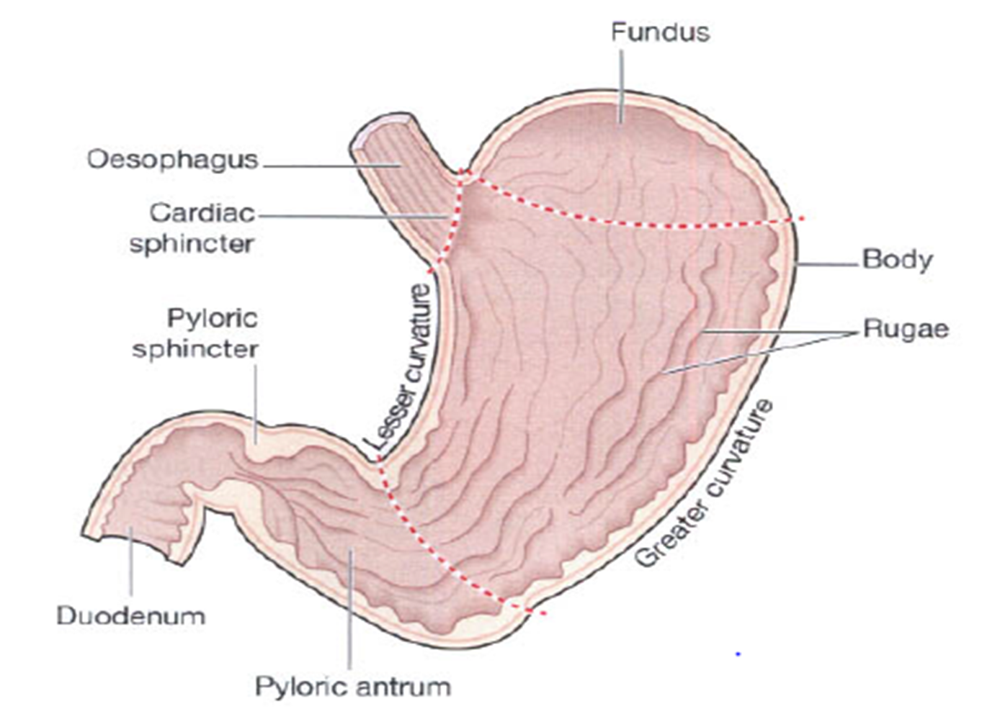
THE STOMACH

Slide 57
THE LONGITUNDINAL SECTION OF THE STOMACH

Slide 58
Functions of the Stomach
Temporary reservoir
Production of gastric juice
Absorbing water, vitamins and alcohol
Moving the food into the next point in the digestion process, which is the intestine
Functions of the Gastric Juice
Liquifying of food by the water
Digestion, where hydrochloric acid acidifies the food and stops action of ptyalin that comes with saliva, kills micro-organisms and provides an environment for digestion of proteins by the pepsin
Assisting in absorption of vitamin B12 through intrinsic factor
Mucus, which prevents autodigestion by the hydrochloric acid
Lubricating the contents

Slide 59
GASTRITIS
Gastritis (inflammation of the gastric or stomach mucosa) is a common GI problem.
Gastritis may be acute, lasting several hours to a few days, or chronic, resulting from repeated exposure to irritating agents or recurring episodes of acute gastritis.
Acute gastritis is often caused by:
1. dietary indiscretion—a person eats food that is irritating, too highly seasoned, or contaminated with disease-causing microorganisms.

Slide 60
CONT.
Other causes of acute gastritis include :
overuse of aspirin and other nonsteroidal anti-inflammatory drugs (NSAIDs),
excessive alcohol intake,
bile reflux,
radiation therapy.
A more severe form of acute gastritis is caused by the ingestion of strong acid or alkali, which may cause the mucosa to become gangrenous or to perforate. Scarring can occur, resulting in pyloric stenosis or obstruction.
Acute gastritis also may develop in acute illnesses, especially when the patient has had major traumatic injuries; burns; severe infection; hepatic, renal, or respiratory failure; or major surgery.
Gastritis may be the first sign of an acute systemic infection.

Slide 61
CONT’D
Chronic gastritis and prolonged inflammation of the stomach may be caused either by benign or malignant ulcers of the stomach or by the bacteria Helicobacter pylori.
Chronic gastritis is sometimes associated with:
Autoimmune diseases such as pernicious anemia;
Dietary factors such as caffeine;
The use of medications such as NSAIDs alcohol;
smoking;
chronic reflux of pancreatic secretions and bile into the stomach.

Slide 62
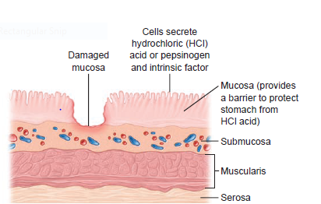
In gastritis, the gastric mucous membrane becomes edematous and hyperemic (congested with fluid and blood) and undergoes superficial erosion. It secretes a scanty amount of gastric juice, containing very little acid but much mucus. Superficial ulceration may occur and can lead to hemorrhage.
EROSIVE GASTRITIS

Slide 63
Clinical manifestation
The patient with acute gastritis may have a rapid onset of symptoms, such as :
abdominal discomfort,
headache,
lassitude,
nausea,
anorexia,
vomiting, and
hiccupping,
These symptoms can last from a few hours to a few days.

Slide 64
Diagnostic findings
Upper GI x-ray series or
Endoscopy and histologic examination of a tissue specimen
Stool test for Helicobacter pylori, blood
Blood test for H. pylori, FBC, LFTS, renal function and gall bladder.

Slide 65
Medical management
The gastric mucosa is capable of repairing itself after an episode of gastritis. As a rule, the patient recovers in about
1 day, although the appetite may be diminished for an additional 2 or 3 days.
Acute gastritis is also managed by instructing the patient to refrain from alcohol and food until symptoms subside.
When the patient can take nourishment by mouth, a nonirritating diet is recommended. If the symptoms persist, intravenous (IV) fluids may need to be administered.
If gastritis is caused by ingestion of strong acids or alkalis, emergency treatment consists of diluting and neutralizing the offending agent.
To neutralize acids, common antacids (e.g., aluminum hydroxide) are used; to neutralize an alkali, diluted lemon juice or diluted vinegar is used.
If corrosion is extensive or severe, emetics and lavage are avoided because of the danger of perforation and damage to the esophagus.

Slide 66
Medical management cont’
Therapy is supportive and may include nasogastric (NG) intubation, analgesic agents and sedatives, antacids, and IV fluids.
In extreme cases, emergency surgery may be required to remove gangrenous or perforated tissue.
A gastric resection or a gastrojejunostomy (anastomosis of jejunum to stomach to detour around the pylorus) may be necessary to treat pyloric obstruction, a narrowing of the pyloric orifice, which cannot be relieved by medical management.
Chronic gastritis is managed by modifying the patient’s diet, promoting rest, reducing stress, recommending avoidance of alcohol and NSAIDs, and initiating pharmacotherapy.
H. pylori may be treated with selected drug combinations

Slide 67
Nursing management
Reducing anxiety: the nurse uses calm approach to asses the patient and answer all questions as completely as possible. It is important to explain all procedure and treatments based on the patients level of education.
Promoting optimal nutrition: the patient should take no food or fluids by mouth-possibly for a few day until acute symptoms subside and allow the mucosal. The patient should avoid caffeinated beverages because caffeine is a CNS stimulant and it increases gastric activity and pepsin secretion.
Fluid and electrolyte balance: to the nurse monitors fluid intake and output along with serum electrolyte values. After the symptoms subside, the nurse may offer the patient ice chips followed by clear liquids.

Slide 68
The nurse must always be alert for any indicators of hemorrhagic gastritis, which include hematemesis (vomiting of blood), tachycardia, and hypotension. If these occur, the physician is notified
Monitor patient’s vital signs are monitored as the patient’s condition warrants.
Pain relieve: instructing the patient to avoid foods and beverages that may be irritating to the gastric mucosa and instructing the patient about the correct use of medications to relieve chronic gastritis.
Teach patient on self care: how to take the medication as prescribed, hygiene, signs of complications like blood in stool, importance for coming for follow up care.

Slide 69
2. Peptic ulcer disease
A peptic ulcer may be referred to as a gastric, duodenal, or esophageal ulcer, depending on its location.
A peptic ulcer is an excavation (hollowed-out area) that forms in the mucosal wall of the stomach, in the pylorus (the opening between the stomach and duodenum), in the duodenum (the first part of the small intestine), or in the esophagus.
Erosion of a circumscribed area of mucous membrane is the cause
This erosion may extend as deeply as the muscle layers or through the muscle to the peritoneum.
Peptic ulcers are more likely to occur in the duodenum than in the stomach.
Peptic ulcer occur in areas of the GIT that contact with HCL and proteolytic enzyme (pepsin)

Slide 70
Risk factors
Smoking
Habitual use of non steroidal anti-inflammatory drugs
Alcohol
Chronic diseases
Infections of the gastric and duodenal mucosa and helicobacter pylori
The predisposing factors to peptic ulceration are related to imbalance between acid and pepsin production, and the mucosal barrier. Destruction of the mucosal barrier leads to ulceration. Increased acid-pepsin production is associated with increased numbers of acid producing cells and increased sensitivity of parietal cells to stimuli like alcohol, caffeine and so on.

Slide 71
Types of PUD : 1. OESOPHAGEAL ULCER
These are erosions or ulcerations of oesophageal mucosa which can occur in patients with reflux oesophagitis. Presence of an incompetent lower oesophageal sphincter or hiatal hernia predispose to reflux of acidic gastric contents into the lower portion of the oesophagus, which then causes the erosion.
Clinical Manifestations
Heart burn
Epigastric distress that may radiate to the back or lower abdomen
Oesophageal stricture (due to recurrent oesphagitis and replacement of mucosa with scar tissue

Slide 72
2. Gastric ulcer
Gastric ulcer can develop on any part of the stomach and occur about equally in males and females. Patients with gastric ulcers are generally older than patients with duodenal ulcers.
Pathophysiology
Gastric ulcers frequently develop in the antrum of the stomach and usually the ulcer is round or oval shaped and has the appearance of a punched-out cavity with an inflammatory base. The primary defect is usually an abnormality that increases the mucosal barrier permeability to hydrogen ions.

Slide 73
Other factors in the causation of gastric ulcers include:-
Duodenal reflux of bile
Use of ulcerogenic drugs
Decreased mucosal synthesis of prostaglandins.
Chronic gastritis

Slide 74
3. Duodenal ulcer
Ulcers involving the duodenum are common than gastric ulcers. Duodenal ulcers are characteristically deep, penetrating through the sub mucosal layers of the intestinal wall.
Duodenal ulcers tend to develop in younger persons and in persons with type O blood.
Diagnosis is by endoscopy and barium studies

Slide 75
Pathophysiology
These ulcers may result from increased gastric acid secretion, defective duodenal alkalinisation or decreased resistance of the duodenal mucosa to acid.
Stress with its activation of the autonomic nervous system and increase in acid secretion may aggravate ulcer disease or encourage ulcer development.
Other factors associated with duodenal ulcer disease include cigarette smoking, cirrhosis and chronic renal failure
Blood group O.

Slide 76
Other factors in the causation of gastric ulcers include:-
Duodenal reflux of bile
Use of ulcero-genic drugs
Decreased mucosal synthesis of prostaglandins.
Chronic gastritis

Slide 77
Clinical manifestation of PUD
Epigastria pain which may radiate to the lower abdomen, sternum or back.
Pain follows a pain-food-relief cycle (food relieves the pain by buffering HCL).
Pain occurs one to three hours after a meal and is relieved by food or antacid.
Pain associated with gastric ulcers located high in the epigastrium and occurs spontaneously about one to two hours after a meal.
If the ulcer has eroded through the gastric mucosa food tends to aggravate rather than alleviate the pain. (GASTRIC) In duodenal ulcers the pain usually occurs two to four hr.s after meals and is relieved by antacids and foods that neutralise and dilute HCL acid.

Slide 78
Clinical manifestation cont’
Melena –due to oxidized iron from hemoglobin
Loss of appetite and weight loss
Bloating and abdominal fullness
Hematemesis –bleeding
vomiting
Water brush –rush of saliva after an episode of regurgitation
Heart burn (pyrosis) common when stomach is empty
Constipation or diarrhea

Slide 79
Complication Of PUD
Pyloric obstruction
Haemorrhage
Perforation
Stenosis and obstruction
Penetration to other organs e.g. to the liver

Slide 80
Management of a patient with PUD
It was mentioned earlier that peptic ulcers might affect any part of the gut. The care of patients suffering from peptic ulcers involves first investigating and ascertaining that the patient has peptic ulceration.
When planning care for the patient with peptic ulceration,
The goals of care should include:
Reduction of pain and discomfort
Reduction in complications
Complete healing of the peptic ulcer
Changes in the lifestyle which led to the ulcer healing
Compliance with management regime

Slide 81
MGT of a patient with PUD cont’
The care of patients suffering from peptic ulcers involves first investigating and ascertaining that the patient has peptic ulceration.
Conservative management :
The patient with acute exacerbation and no accompanying complications requires:
nil per oral.
They also requires naso-gastric suction
bed rest to moderate light activity.
They should receive IV fluids, medication and sedation.
a bland diet of six small meals a day
stress reduction. \The patient should cease smoking.

Slide 82
Medical Management
They will also be given drugs that will protect the ulcer, neutralise the acid, or decrease the production of acid. The drugs are antacids, H2 receptor blocking agents, anticholinergics, cytoprotective drugs, sodium-potassium ATPase inhibitors and misoprostol. Do not worry about the names of the dugs. You may be more familiar with their proprietary names.

Slide 83
Antacids - they decrease gastric acidity and acid content of chyme reaching the duodenum.
Histamin H2 - receptor antagonists. These include cimetidine (tagamet), ranitidine (zantac), famotidine (pepcid) and nizatidine (axid). These drugs block the action of histamine on the H2 receptors and this reduce HCL secretion and accelerates ulcer healing.
Proton pump inhibitors - These include omeprazole (prilosec), lansoprazole (pruscacid) and pantoprazole (pantoloc). They block the ATPase enzyme that is important for the secretion of gastric acid.
Antibiotic therapy - This is given when presence of helicobacter pylori has been confirmed.
If there is perforation surgical intervention pre and post operative care.

Slide 84
DIFFERENCE BETWEEN Gastric ulcer duodenal ulcer
Occurs in the stomach.
Pain occurs 1-2 hours after eating.
Pain is not related to eating.
Causes haematemesis.
Has a special diet.
Peak 50-60 year.
Normal or decrease gastric secretion.
Heamorrhage, perforation.
15% of PUD are gastric.
Occurs in the duodenum.
Occurs 3-4 hours later.
Pain is relieved by eating.
Causes melena or bloody stool.
No special diet.
Peak 35-45 years.
Increased gastric secretion between meals, after meals and during the night.
Haemorrhage perforation and outlet and outlet obstruction.
80% of PUD are duodenum.

Slide 85
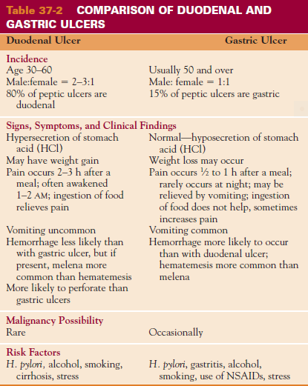

Slide 86
Cancer of the stomach

Slide 87
Pathophysiology
Most gastric cancers are adenocarcinomas; they can occur anywhere in the stomach. The tumor infiltrates the surrounding mucosa, penetrating the wall of the stomach and adjacent organs and structures. The liver, pancreas, esophagus, and duodenum are often already affected at the time of diagnosis. Metastasis through lymph to the peritoneal cavity occurs later in the disease.

Slide 88
Risk factors
A diet high in smoked ,salted or pickled (preserved in vinegar)foods and low in fruit and vegetables
Chronic inflammation of stomach
H pylori infection
Pernicious anemia
Smoking
Genetics
Gastric ulcers
Previous gastrectomy

Slide 89
Clinical manifestation
Symptoms of early disease, such as:
Pain relieved by antacids, resemble those of benign ulcers
Symptoms of progressive disease:
Include dyspepsia (indigestion),
Early satiety,
Weight loss,
Abdominal pain just above the umbilicus,
Loss or decrease in appetite,
Bloating after meals,
Nausea and vomiting,
Symptoms similar to those of peptic ulcer disease.

Slide 90
Diagnosis:
Advanced cancer
Palpable mass
Ascites and hepatomegally
Palpable nodules around umbilicus—sister mary joseph’s nodules (usually gastric cancer)
Barium x ray
Endoscopy plus biopsy
Computer tomography scan (CT scan)
esophagogastroduodenoscopy

Slide 91
Management
The patient with cancer of the stomach may require:
surgery
radiation,
chemotherapy
OR combination of these (surgery, chemotherapy and radiotherapy)
The surgical aim is to remove as much of the stomach as is necessary to remove the tumour and a margin of normal tissue.. The condition is common in the elderly. These patients may be unfit for surgery in many cases hence the need for conservative management.
The nutritional management may require that the patient have a stoma for delivery of food to the stomach. Nutrition, fluid and electrolyte balance, and treatment of anaemia are all very important

Slide 92
Nursing Diagnosis For A Patient With Cancer Of The Stomach
Anxiety related to the disease and anticipated treatment
Imbalanced nutrition, less than body requirements, related to early satiety or anorexia
Pain related to tumor mass
Anticipatory grieving related to the diagnosis of cancer
Deficient knowledge regarding self-care activities

Slide 93
CONT…
The organisms that are commonly associated with peritonitis include:
Escherichia coli,
streptococci,
staphylococci
pseudomonas.

Slide 94
Clinical manifestation
Acute Pain is usually intensified on movement.
Rigid abdomen which is tender to touch.
Rebound tenderness and paralytic ileus or decreased peristalsis.
Fever, nausea and vomiting
Abdominal distension may be present due to movement of fluid into the abdominal cavity.
Signs of shock may be present e.g. tachycardia, low blood pressure, tachypnea
Patient may have hiccups due to irritation of the phrenic nerve
Diagnosis
Abdominal x-ray –shows air and fluid ,and distended bowel loops
Ultra sound –fluid collections ,
CT scan –abscess formation

Slide 95
Management
Management of peritonitis, this is an emergency and the aim at correcting : fluid and electrolyte balance , arresting the infection, and relieving the abdominal pain.
Oxygen therapy promotes adequate oxygenation by nasal cannula or mask
Fluid and electrolyte replacement with several liters of isotonic solution. Hypovolemia occurs because massive amounts of fluid and electrolyte move from the intestinal lumen into the peritoneal cavity and deplete the fluid in the vascular space
Treatment: analgesics are prescribed for pain , antiemetic's for nausea and vomiting and antibiotics in large IV doses
Intestinal intubation and suction assist in relieving abdominal distention..
If peritonitis is a result of perforation, surgical intervention is indicated to close the intestinal wall and to remove exudative material from the peritoneum.

Slide 96
Nursing care
Monitor oxygen therapy
Vital signs especially blood pressure
Monitor input output
Monitor pain ,GI function ,fluid and electrolyte balance
Administer analgesic ,position patient on side with knees flexed for comfort and relieve pain and decrease tension on the abdominal organs
Monitor and record the character of drainage

Slide 97
Complications
Sepsis –major cause of death
Shock due to hypovolemia or septicemia
Intestinal obstruction from adhesions

Slide 98
Nursing diagnosis
Fluid volume deficit
Acute pain
Anxiety/fear
Knowledge deficit
Risk for imbalanced nutrition less than the body requirement
Risk for infection

Slide 99
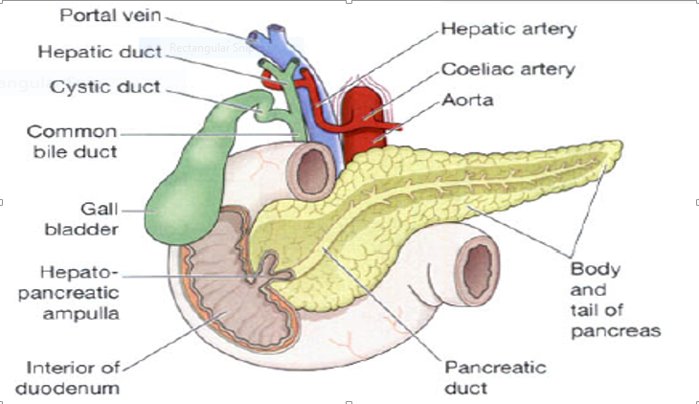
The Pancreas In Relationship To The Duodenum And The Biliary Tract

Slide 100
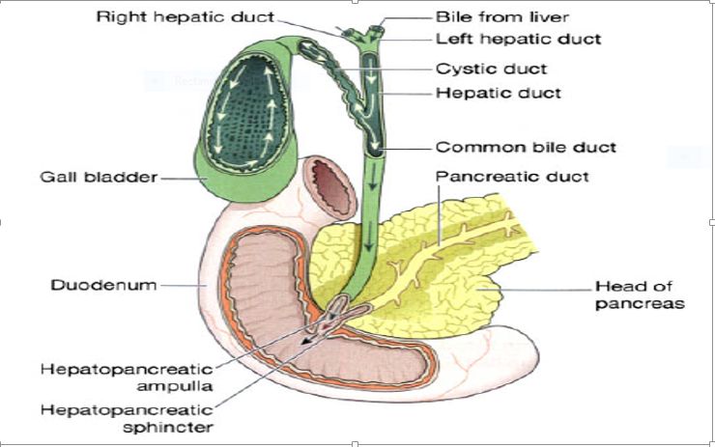
THE FLOW OF BILE

Slide 101
COMMON TERMINOLOGIES
Explore common terminologies in GIT

Slide 102
Achalasia: absent or ineffective peristalsis (wavelike contraction) of the distal esophagus accompanied by failure of the esophageal sphincter to relax in response to swallowing
Dysphagia: difficulty swallowing
Dysplasia: abnormal change in cells
Esophagogastroduodenoscopy (EGD): passage of a fiberoptic tube through the mouth and throat into the digestive tract for visualization of the esophagus,stomach, and small intestine; biopsies can be performed
Gastroesophageal reflux: back-flow of gastric or duodenal contents into the esophagus
Hernia: protrusion of an organ or part of an organ through the wall of the cavity that normally contains it
Lithotripsy: use of shock waves to break up or disintegrate stones
Odynophagia: pain on swallowing
Parotitis: inflammation of the parotid gland
Periapical abscess: abscessed tooth
Pyrosis: heartburn
Sialadenitis: inflammation of the salivary glands
Stomatitis: inflammation of the oral mucosa
Temporomandibular disorders: a group of conditions that cause pain or dysfunction of the temporomandibular joint (TMJ) and surrounding structures
Vagotomy syndrome: dumping syndrome; gastrointestinal symptoms, such as diarrhea and abdominal cramping, resulting from rapid gastric emptying
Xerostomia: dry mouth

Slide 103
Nursing process
Nursing Diagnosis
Based on the assessment data, the nursing diagnoses may include the following:
Imbalanced nutrition, less than body requirements, related to difficulty swallowing
• Risk for aspiration related to difficulty swallowing or to tube feeding
• Acute pain related to difficulty swallowing, ingestion of an abrasive agent, tumor, or frequent episodes of gastric reflux
• Deficient knowledge about the esophageal disorder, diagnostic studies, medical management, surgical intervention, and rehabilitation
Planning and Goals
The major goals for the patient may include attainment of adequate nutritional intake, avoidance of respiratory compromise from aspiration, relief of pain, and increased knowledge level.

Slide 104
Nursing Interventions
Encouraging Adequate Nutritional Intake
The patient is encouraged to eat slowly and to chew all food thoroughly so that it can pass easily into the stomach.
Small, frequent feedings of nonirritating foods are recommended to promote digestion and to prevent tissue irritation.
Sometimes liquid swallowed with food helps the food pass through the esophagus, but usually liquids should be consumed between meals.
Food should be prepared in an appealing manner to help stimulate the appetite.
Irritants such as tobacco and alcohol should be avoided.
A baseline weight is obtained, and daily weights are recorded.
The patient’s intake of nutrients is assessed.

Slide 105
Decreasing Risk of Aspiration
The patient who has difficulty swallowing or difficulty handling secretions should be kept in at least a semi-Fowler’s position to decrease the risk of aspiration.
The patient is instructed in the use of oral suction to decrease the risk of aspiration further.
Relieving Pain
Small, frequent feedings (six to eight per day) are recommended because large quantities of food overload the stomach and promote gastric reflux.
The patient is advised to avoid any activities that increase pain and to remain upright for 1 to 4 hours after each meal to prevent reflux. The head of the bed should be placed on 4- to 8-inch (10- to 20-cm) blocks.
Eating before bedtime is discouraged.
The patient is advised that excessive use of over-the counter antacids can cause rebound acidity.
Antacid use should be directed by the primary care provider, who can recommend the daily, safe dose needed to neutralize gastric juices and prevent esophageal irritation.
H2 antagonists are administered as prescribed to decrease gastric acid irritation.
Promote patient education
Promote home and community based care

Slide 106
